Slide 1
Layernorm v.s. Batchnorm

Slide 2
Why we use normalization?
The goal of normalization is to change the values of numeric columns in the dataset to use a common scale, without distorting differences in the ranges of values or losing information.
For example, if you’re working with a dataset of student loans with the age of the student and the tuition as two input features, the two values are on totally different scales. While the age of a student will have a median value in the range 18 to 25 years, the tuition could take on values in the range $20K - $50K for a given academic year.
If you proceed to train your model on such datasets with input features on different scales, you’ll notice that the neural network takes significantly longer to train because the gradient descent algorithm takes longer to converge when the input features are not all on the same scale.
Additionally, such high values can also propagate through the layers of the network leading to the accumulation of large error gradients that make the training process unstable, called the problem of exploding gradients

Slide 3
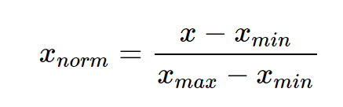
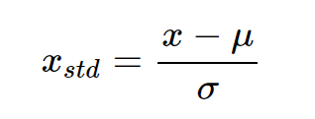
Normalization vs Standardization
Normalization works by mapping all values of a feature to be in the range [0,1].
Standardization, on the other hand, transforms the input values such that they follow a normal distribution with zero mean and unit variance (unit Gaussian).
In practice, this process of standardization is also referred to as normalization (not to be confused with the normalization process discussed above).
Notes:
Normalization is used when the data doesn't have Gaussian distribution whereas Standardization is used on data having Gaussian distribution.
Normalization scales in a range of [0,1] or [-1,1]. Standardization is not bounded by range.
Normalization is highly affected by outliers. Standardization is slightly affected by outliers.
Normalization is considered when the algorithms do not make assumptions about the data distribution. Standardization is used when algorithms make assumptions about the data distribution.
What Do Normalization and Standardization Mean? When to Normalize Data and When to Standardize Data? | by Akalbir Singh Chadha | Becoming Human: Artificial Intelligence Magazine

Slide 4





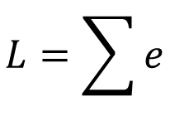







Changing Landscape
Loss L
smooth
small
$$+∆y$$
$$w_{1}$$
$$+∆w_{1}$$
$$\hat{y}$$
$$y$$
$$x_{1}$$
1, 2 ……
$$e$$
$$+∆e$$
small
small
$$b$$
$$L=\sum{e}$$
$$w_{2}$$
1
$$x_{2}$$
$$+∆L$$
small
Notes:
Make different features have the same scaling

Slide 5




Changing Landscape
Loss L
Loss L
steep
smooth
large
$$+∆y$$
$$w_{1}$$
$$\hat{y}$$
$$y$$
$$x_{1}$$
1, 2 ……
$$e$$
$$+∆e$$
small
same
range
large
$$b$$
$$L=\sum{e}$$
$$w_{2}$$
1
$$+∆w_{2}$$
$$x_{2}$$
100, 200 ……
$$+∆L$$
large
large
Notes:
Make different features have the same scaling
W1 和 w2 是network中的參數，假設scale差距很大，只用固定的LR很難train，所以才需要adaptive LR, adam這些比較進階的optimization的方法，
這邊從另外一個角度，直接把難train的error surface 改掉
Convex這種斜率差很多的狀況是如何產生的

Slide 6
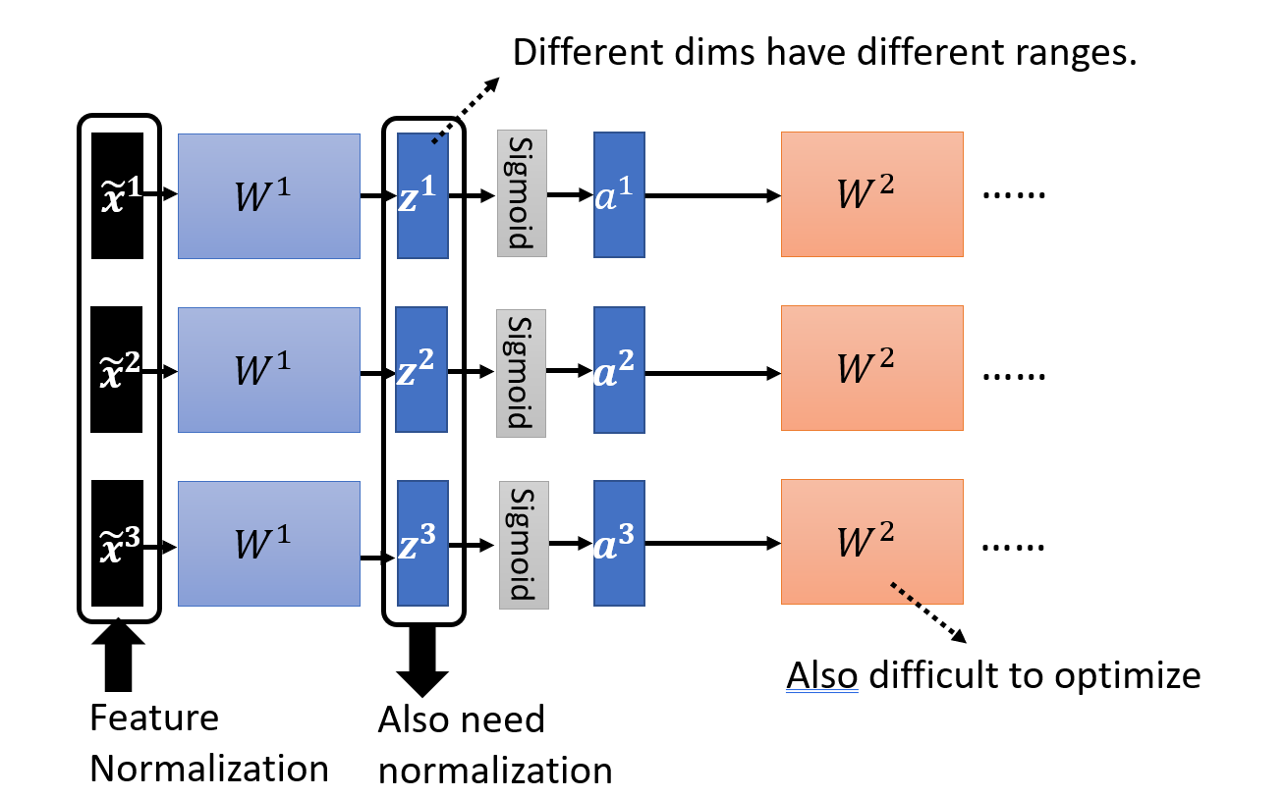
Need for Batchnorm/Layernorm

Slide 7
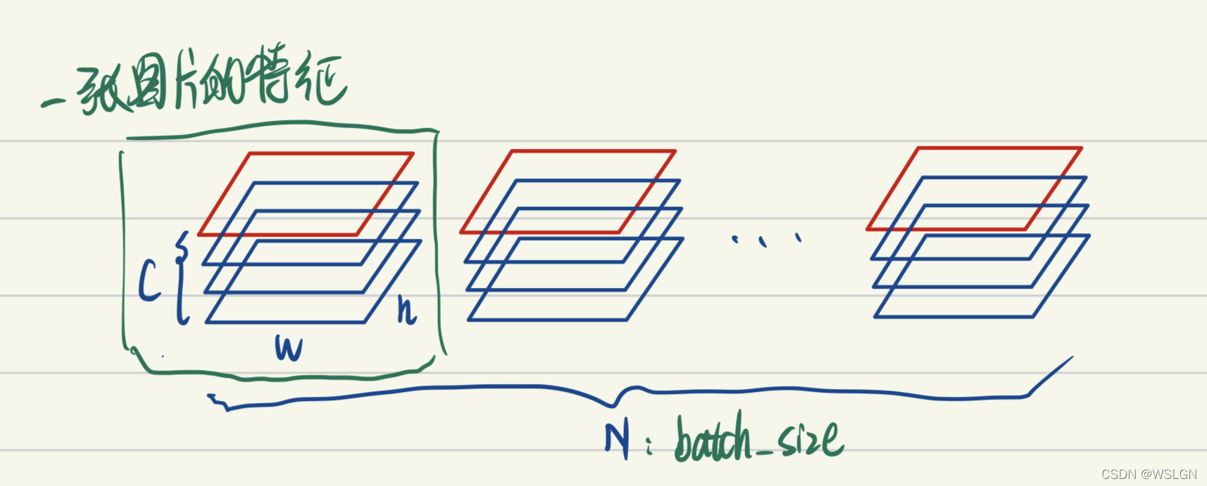
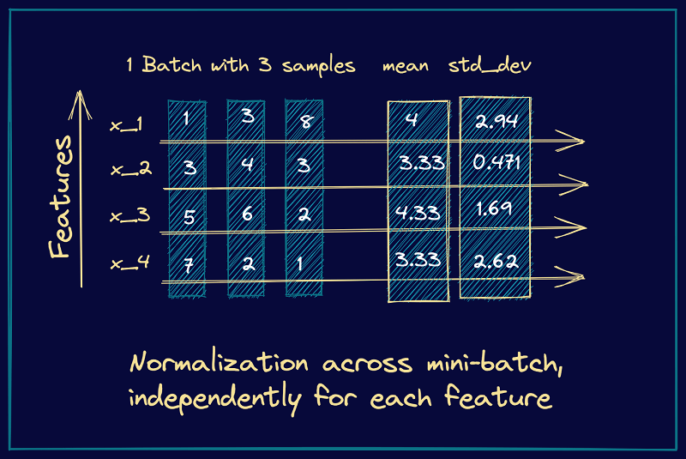
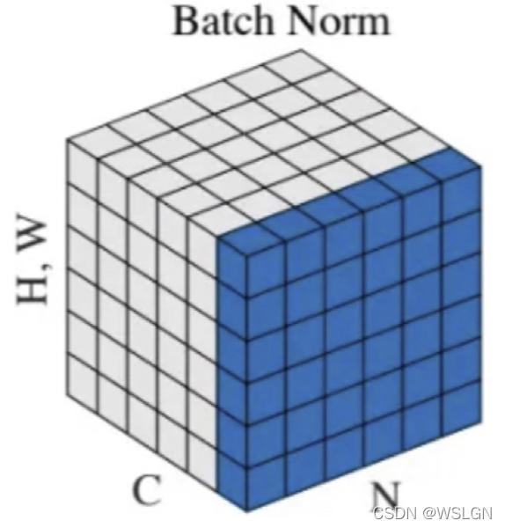






Batch Normalization

Slide 8
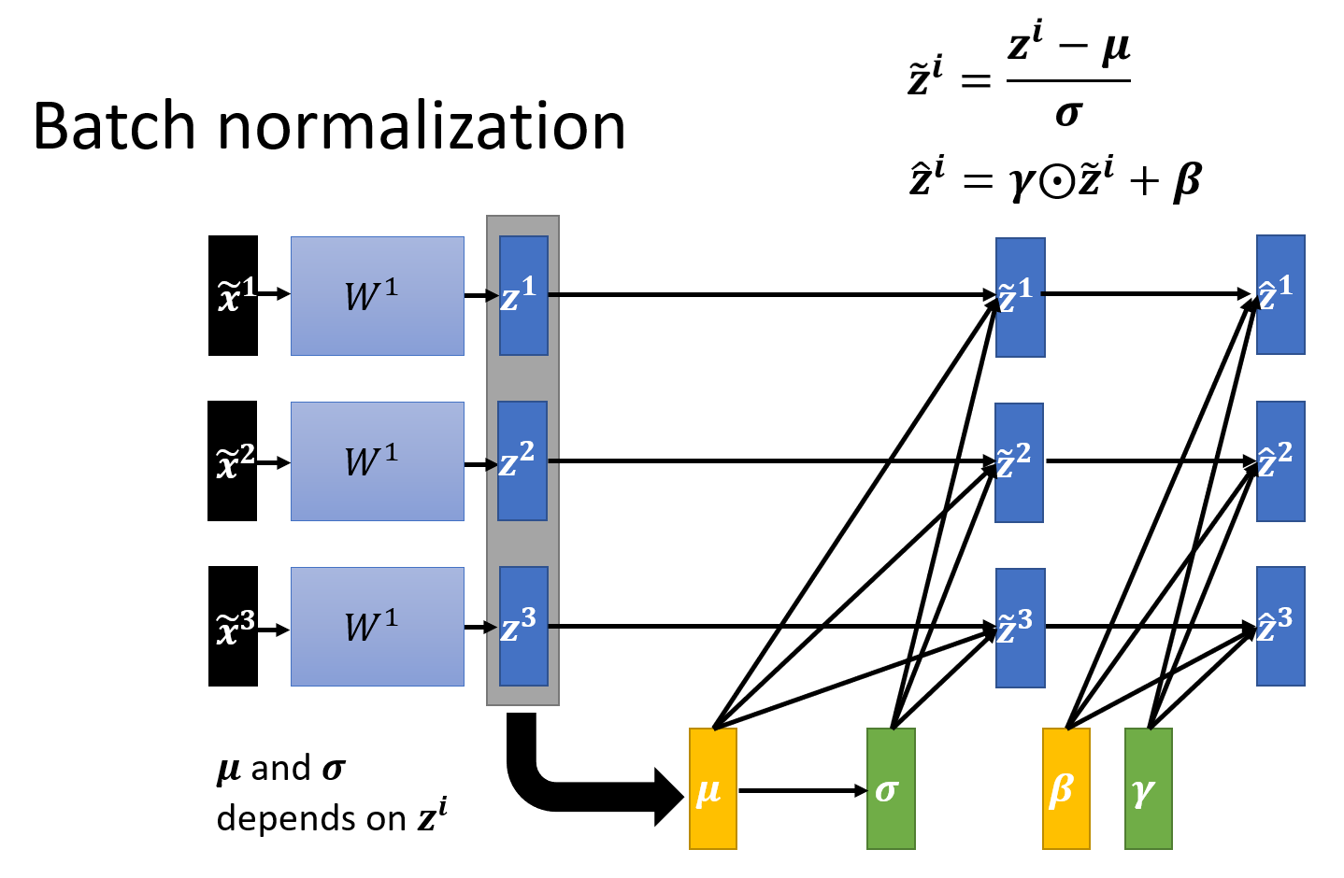
However, forcing all the pre-activations to be zero and unit standard deviation across all batches can be too restrictive. It may be the case that the fluctuant distributions are necessary for the network to learn certain classes better.

Slide 9
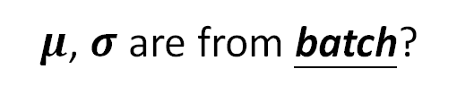


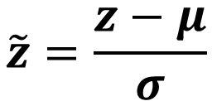







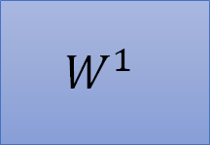
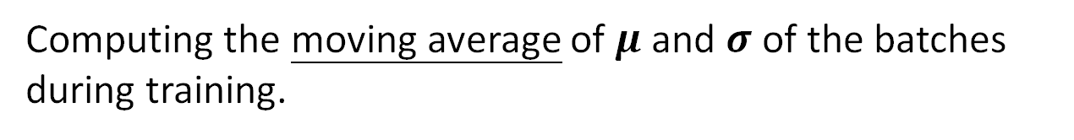

Batch normalization – Testing
$$\tilde{z}=\frac{z−μ}{σ}$$
$$\overline{μ}$$
$$\tilde{x}$$
$$W^{1}$$
$$z$$
$$\overline{σ}$$
$$\tilde{z}$$
……
$μ$, $σ$ are from batch?
We do not always have batch at testing stage.
Computing the moving average of $μ$ and $σ$ of the batches during training.
$$μ^{1}$$
$$μ^{2}$$
$$μ^{3}$$
……
$$μ^{t}$$
$$\overline{μ}←p\overline{μ}+\left(1−p\right)μ^{t}$$
Notes:
上學期好多人做!
https://ntumlds.wordpress.com/2017/03/26/r05922005_rrrr/

Slide 10
Limitations of Batch Normalization
In batch normalization, we use the batch statistics: the mean and standard deviation corresponding to the current mini-batch. However, when the batch size is small, the sample mean and sample standard deviation are not representative enough of the actual distribution and the network cannot learn anything meaningful.
As batch normalization depends on batch statistics for normalization, it is less suited for sequence models. This is because, in sequence models, we may have sequences of potentially different lengths and smaller batch sizes corresponding to longer sequences.

Slide 11









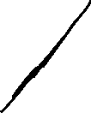
























Slide 12
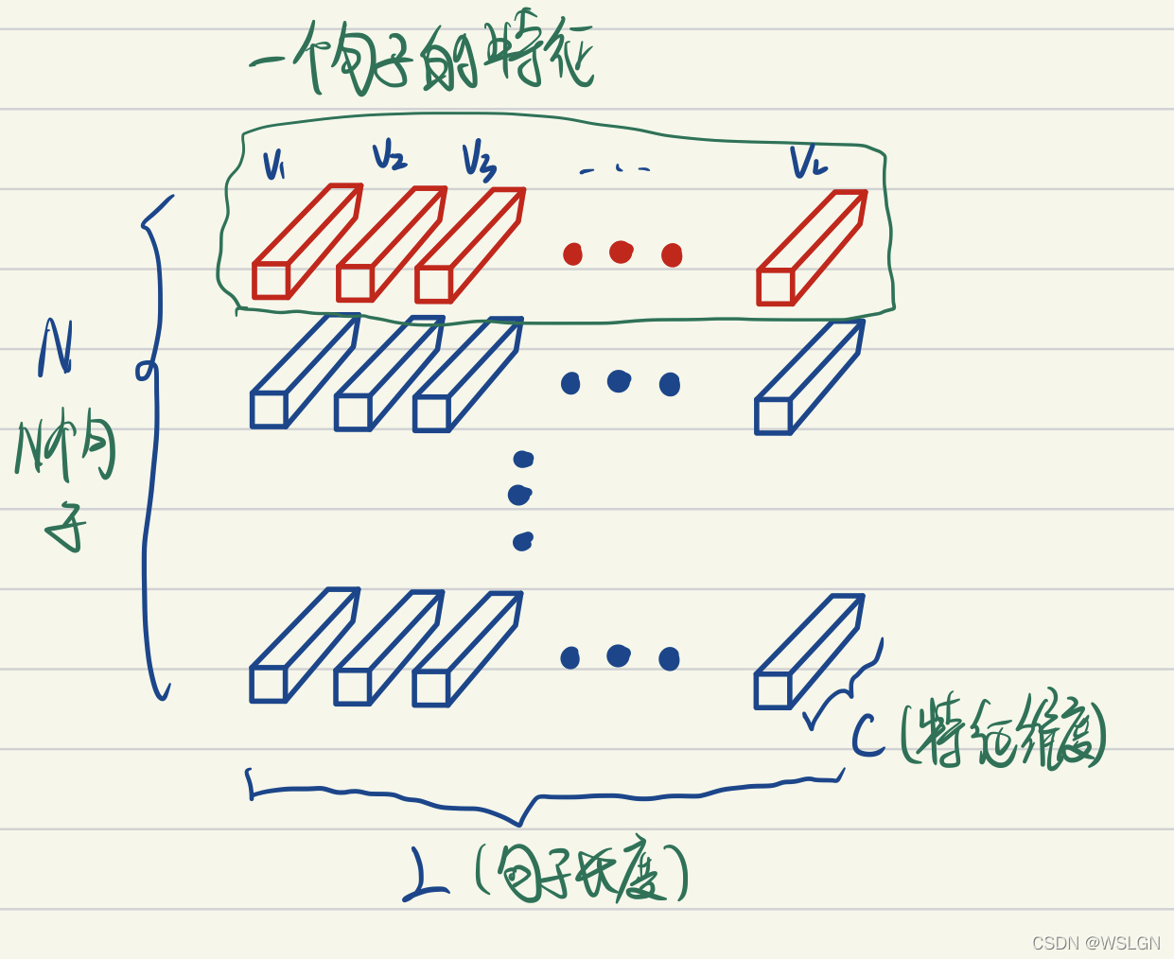
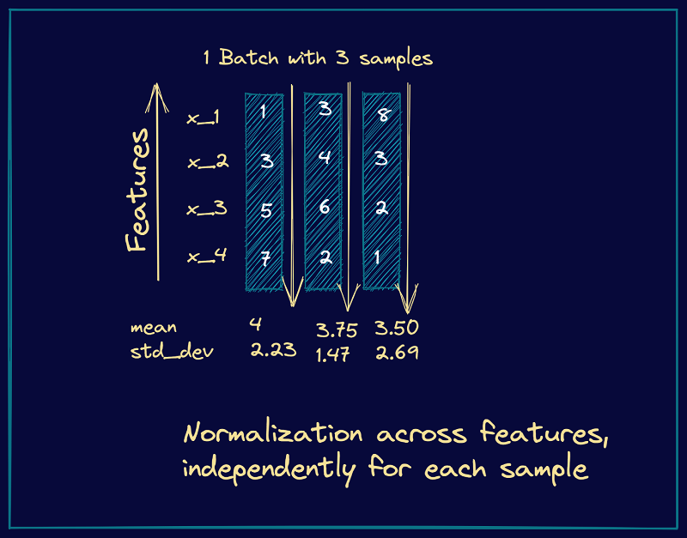
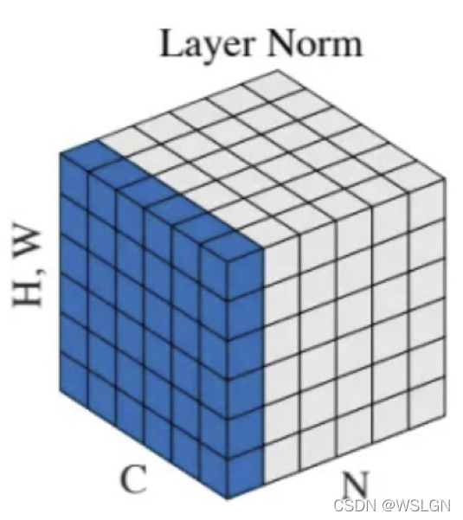






Layer Normalization

Slide 13


Slide 14
Layernorm and Batchnorm difference
Batch normalization normalizes each feature independently across the mini-batch. Layer normalization normalizes each of the inputs in the batch independently across all features.
As batch normalization is dependent on batch size, it’s not effective for small batch sizes. Layer normalization is independent of the batch size, so it can be applied to batches with smaller sizes as well.
Batch normalization requires different processing at training and inference times. As layer normalization is done along the length of input to a specific layer, the same set of operations can be used at both training and inference times.
Layer normalization applied on CNN could destroy the feature obtained from the convolution. Batch normalization would be better in CNN, because the normalization would not be much easier to lose information in the same feature.
Layer normalization is usually use in NLP. Batch normalization is usually use in CV.

